Slide 1
RONOG 4 - Bucharest
Diego Luis Neto
SW developer @ NL-ix

Slide 2
RONOG 4 - Bucharest
BIRD-Stack
Automatic BIRD configuration with StackStorm

Slide 3
Route-server limitations
No peers selection possibility
Mostly manual
Time consuming
Not transparent

Slide 4
BIRD-Stack
A “framework” for automatic BIRD configuration and management

Slide 5
Stackstorm
Brocade product
Runs on Linux, made with/for Python coherent with NL-ix tech stack
Event driven
Actions, rules, workflows, audit
Plugin structure
Wide selection of available packs (https://exchange.stackstorm.org/)

Slide 6
BIRD-Proxy
Flask (Python) application
BIRD control via HTTP(S) operations exposed via web endpoints

Slide 7
BIRD St2 pack
bird
Feature-rich BIRD config file generation
Automatic configuration deployment
Prefixes information retrieval and storage
BIRD status queries

Slide 8
BIRD configuration features
Custom templating
Filter and prepend support
Members black/white-listing
IRR DB info prefixes filtering
DROP lists filtering
Fullbogons filtering

Slide 9
Generate config
St2 pack
config
Peers
Data
BIRD config
Template
IRR DB
Info
DROP
List
Fullbogons

Slide 10
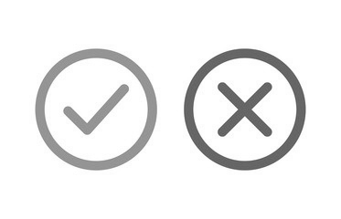
Deploy config
St2 Machine
Route-server

Slide 11
and then…

Slide 12
NL-ix route-server configurator
All BIRD-Stack functionalities
+
Geobased filtering
Latency based filtering
PeeringDB filtering
Extra peering info and stats

Slide 13
NL-ix route-server configurator

Slide 14
BIRD-Stack
https://github.com/NL-ix/bird-stack
stackstorm-community.slack.com #nlix-bird
Info
dlneto@nl-ix.net (@diellenne) nlix@nl-ix.net

Slide 15
Q&A

